Slide 1

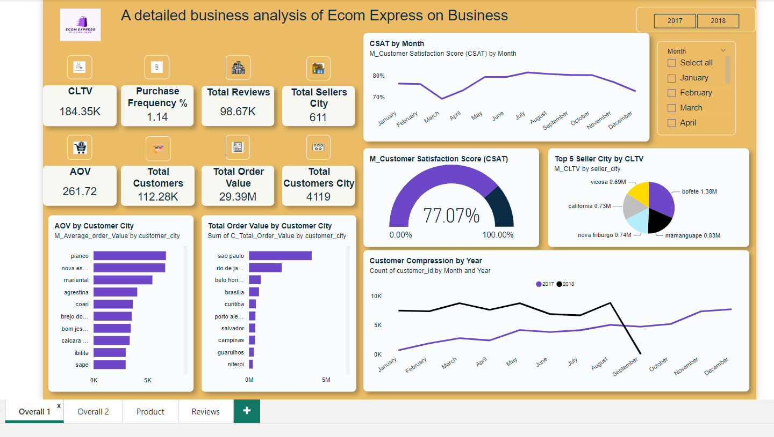

Slide 2
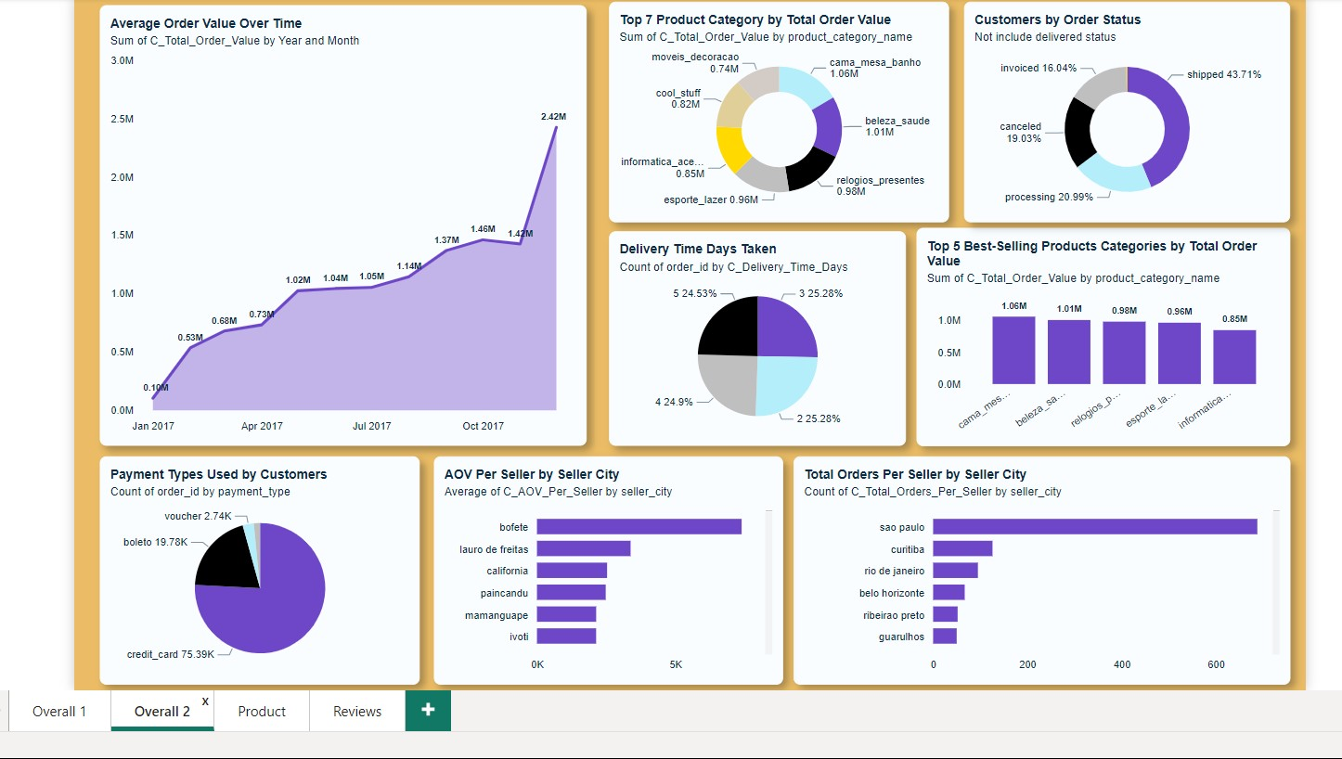

Slide 3
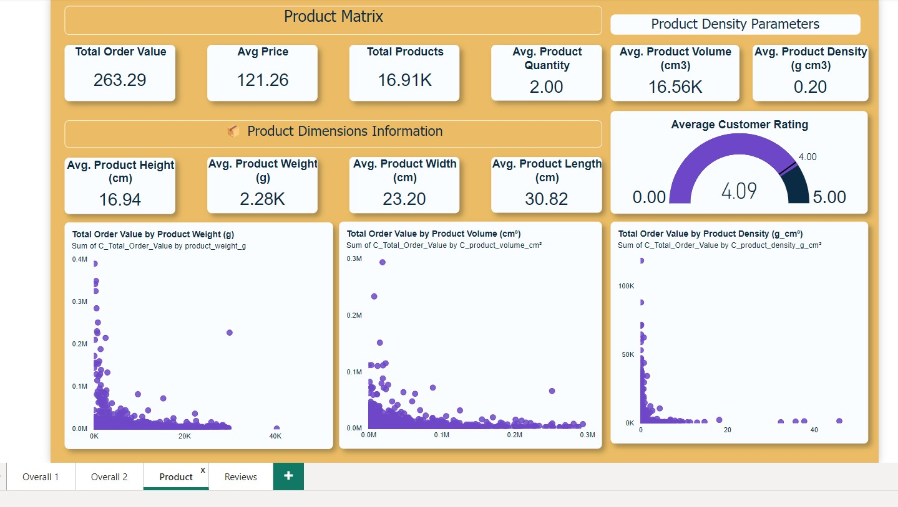

Slide 4
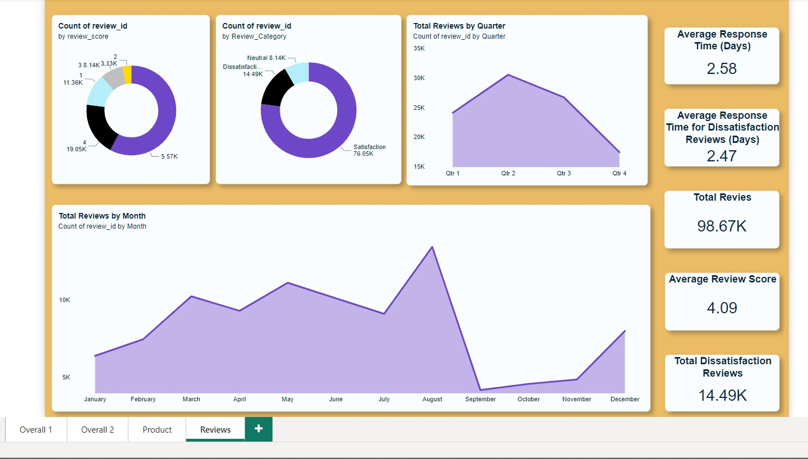

Slide 5
Insight
The months from May to November consistently record the highest number of orders, showcasing seasonal trends or successful marketing campaigns during this time.
A total of 99.44K customers have contributed to an impressive $30 million in sales, with an Average Order Value (AOV) of $266, which is remarkably high.
Pianco stands out with the highest Average Order Value (AOV) of $6,724, highlighting the presence of high-value customers or bulk purchases.
Sao Paulo leads with $4 million in total sales, making it a key market for the business.
The period from December 2017 to May 2018 was the company’s best-ever sales period, reflecting peak market demand and effective business strategies.
Approximately 22% of orders are canceled, a significant metric that warrants further investigation to identify and address underlying causes.
75% of transactions are processed via credit cards, indicating a strong reliance on digital payment options.

Slide 6
Insight
Customer Satisfaction:
76% of customers are satisfied, reflecting a high level of service quality.
14.5% are dissatisfied, indicating opportunities for improvement.
The remaining customers are neutral, suggesting potential for better engagement.
Resolving dissatisfied customer reviews takes an average of 2.47 days, which could be optimized for faster customer satisfaction.
A total of 99K reviews have been received, providing valuable insights for continuous improvement.
The business has an average customer rating of 4.09, which is a positive indicator of overall satisfaction but leaves room for enhancement.

Slide 7
Actionable Strategy
Analyze customer behavior in Pianco City to understand the drivers of this high AOV. Replicate successful strategies in other regions.
Design targeted promotions and special offers for customers in high AOV cities to maximize revenue potential.
Develop VIP programs and exclusive deals for high-spending customers to retain their loyalty and encourage more purchases.
Optimize inventory management to ensure sufficient stock during peak months.
Invest in localized marketing campaigns, partnerships, and events in Sao Paulo to further boost sales.

Slide 8



Contact Us
+91 9924750166
jatinbhavsar000@gmail.com

